Slide 1
Failure Classification

Slide 2
Failure in terms of a database can be defined as its inability to execute the specified transaction or loss of data from the database.
A DBMS is vulnerable to several kinds of failures and each of these failures needs to be managed differently.
There are many reasons that can cause database failures such as network failure, system crash, natural disasters, carelessness, sabotage(corrupting the data intentionally), software errors, etc.

Slide 3
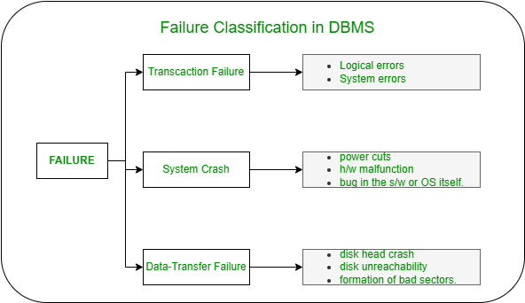
Failure Classification in DBMS
A failure in DBMS can be classified as:

Slide 4
Transaction Failure:
If a transaction is not able to execute or it comes to a point from where the transaction becomes incapable of executing further then it is termed as a failure in a transaction.
Reason for a transaction failure in DBMS:
Logical error: A logical error occurs if a transaction is unable to execute because of some mistakes in the code or due to the presence of some internal faults.
System error: Where the termination of an active transaction is done by the database system itself due to some system issue or because the database management system is unable to proceed with the transaction. For example– The system ends an operating transaction if it reaches a deadlock condition or if there is an unavailability of resources.

Slide 5
System Crash:
A system crash usually occurs when there is some sort of hardware or software breakdown.
Some other problems which are external to the system and cause the system to abruptly stop or eventually crash include failure of the transaction, operating system errors, power cuts, main memory crash, etc.
These types of failures are often termed soft failures and are responsible for the data losses in the volatile memory.
It is assumed that a system crash does not have any effect on the data stored in the non-volatile storage and this is known as the fail-stop assumption.

Slide 6
Data-transfer Failure:
When a disk failure occurs amid data-transfer operation resulting in loss of content from disk storage then such failures are categorized as data-transfer failures.
Some other reason for disk failures includes disk head crash, disk unreachability, formation of bad sectors, read-write errors on the disk, etc.
In order to quickly recover from a disk failure caused amid a data-transfer operation, the backup copy of the data stored on other tapes or disks can be used.
Thus it’s a good practice to backup your data frequently.

